Slide 1
Nobel Prize

Slide 2
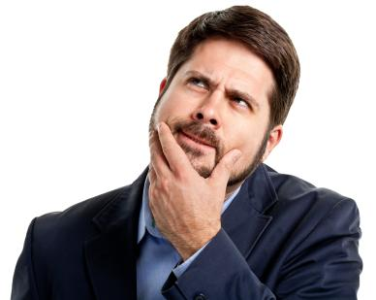
How it all started!
...how did I end up spending 3 hours reading about Nobel Prizes…?

Slide 3
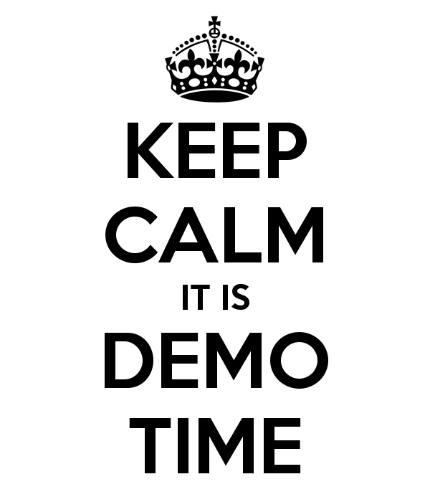
How did we do it?

Slide 4
Future improvements
First of all, UI!
Improvements on scoring! (who doesn’t love machine learning?)
More NLP!
More graphs!
More everything!

Slide 5
Thank you!
Questions?

